Slide 1
FUNCTIONS IN JS (PART 2)
by Ostap Kovbasiuk

Slide 2
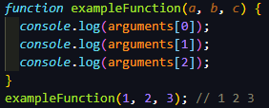
ARGUMENTS PSEUDO-ARRAY
The arguments object is a local variable available within all non-arrow functions. You can refer to a function's arguments inside that function by using its argument object. It has entries for each argument the function was called with, with the first entry's index at 0

Slide 3

ARGUMENTS PSEUDO-ARRAY
It is similar to array, but lacks all properties except length. That’s why it is pseudo. But it can be easily converted to array using Array.from or spread syntax.

Slide 4
CALL() APPLY() BIND()
These 3 methods are used to control the invocation of the function.
call() and apply() were introduced in ECMAScript 3 while bind() was added as part of ECMAScript 5.
You can use call() and apply() to invoke the function immediately. bind() returns a bound function that, when executed later, will have the correct context (this) for calling the original function.

Slide 5
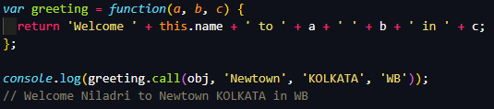
CALL()
The first parameter in call() method sets the "this" value, which is the object, on which the function is invoked upon. The rest of the parameters are the arguments to the actual function.

Slide 6
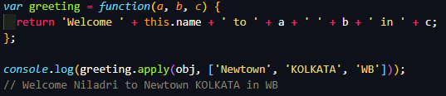
APPLY()
Similarly to call(), the first parameter in apply() method sets the "this" value, which is the object, on which the function is invoked upon. The only difference of apply() with the call() method is that the second parameter of the apply() method accepts the arguments to the actual function as an array.

Slide 7
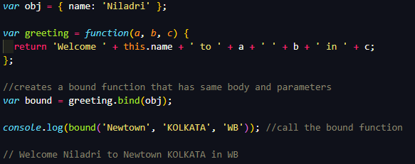
BIND()
The first parameter to the bind() method sets the value of "this" in the target function when the bound function is called. The rest of the parameters following the first parameter in bind() method are passed as arguments which are prepended to the arguments provided to the bound function when invoking the target function.

Slide 8
IIFE
An IIFE (Immediately Invoked Function Expression) is a JavaScript function that runs as soon as it is defined. It is a design pattern which is also known as a Self-Executing Anonymous Function and contains two major parts:
The first is the anonymous function with lexical scope enclosed within the Grouping operator (). This prevents accessing variables within the IIFE idiom as well as polluting the global scope.
The second part creates the immediately invoked function expression () as through which the JavaScript engine will directly interpret the function.

Slide 9

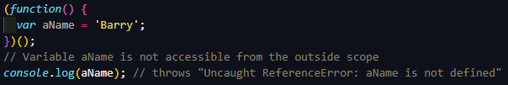
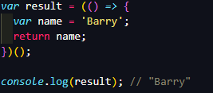
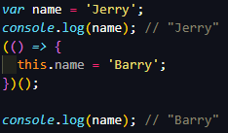
IIFE

Slide 10
CLOSURES
A closure is the combination of a function and the lexical environment within which that function was declared. This environment consists of any local variables that were in-scope at the time the closure was created. A closure gives you access to an outer function’s scope from an inner function. In JavaScript, closures are created every time a function is created, at function creation time.

Slide 11
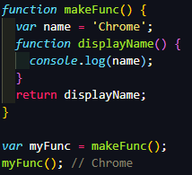
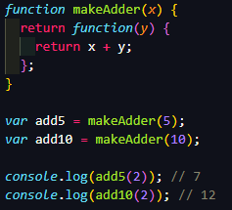
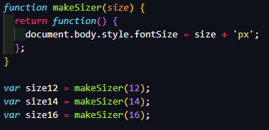
CLOSURES

Slide 12
PREDEFINED FUNCTIONS
Predefined functions are called globally, rather than on an object.
These are:
eval(string) - function evaluates JavaScript code represented as a string.
isFinite(value) - function determines whether the passed value is a finite number.
isNaN(value) - function determines whether a value is NaN or not
parseFloat(value) - function parses an argument and returns a floating point number
parseInt(value, radix) - function parses an argument and returns an integer of the specified radix
decodeURI(), decodeURIComponent(), encodeURI(), encodeURIComponent()

Slide 13
USED LINKS
https://www.codementor.io/@niladrisekhardutta/how-to-call-apply-and-bind-in-javascript-8i1jca6jp
https://developer.mozilla.org/en-US/docs/Glossary/IIFE
https://developer.mozilla.org/en-US/docs/Web/JavaScript/Closures
https://developer.mozilla.org/en-US/docs/Web/JavaScript/Reference/Global_Objects

Slide 14
THANKS FOR ATTENTION

